Slide 1

BANKING

Slide 2

Banking is the business of managing money. Banks are institutions that receive deposits from people and businesses, lend money to borrowers, and offer various financial services to help manage, invest, and grow money.
At its core, banking is about facilitating the flow of money between those who have money to save and those who need money to borrow.

Slide 3
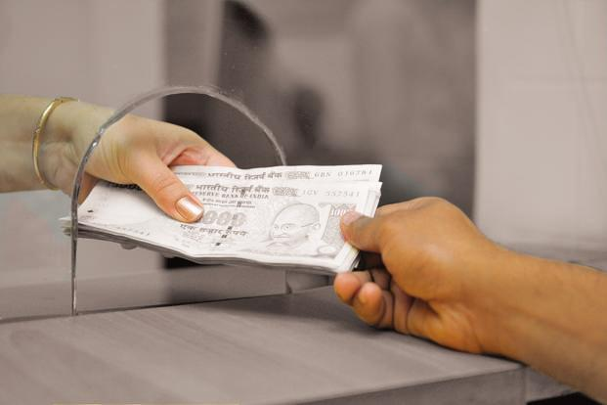
CORE FUNCTIONS
Accepting Deposits:
Banks provide a safe place to store money.
Types of deposits include savings accounts, checking accounts, and fixed deposits.
People deposit money to earn interest or for easy access.

Slide 4

Providing Loans:
Banks lend money to individuals, businesses, and governments.
This helps people buy homes, start businesses, or invest in growth.
Banks charge interest on these loans, which is a primary source of their income.

Slide 5

Facilitating Payments:
Banks offer services like credit/debit cards, online banking, and mobile payments.
They help transfer money locally and internationally through systems like NEFT, RTGS, and SWIFT.

Slide 6

Wealth Management & Investment Services:
Banks provide investment products like mutual funds, stocks, bonds, etc.
They offer financial advice to individuals and businesses to grow their wealth.

Slide 7

Foreign Exchange & Trade Services:
Banks help with currency exchange for international travel and trade.
They support global businesses through letters of credit, trade financing, etc.

Slide 8

HOW DOES BANKING WORK?
Accepting Deposits (The Source of Funds)
Individuals and businesses deposit money into their accounts.
The bank pays interest on these deposits (though often low).

Slide 9

Lending Money (The Use of Funds)
Banks lend part of the deposited money to borrowers (for homes, businesses, education, etc.).
Borrowers pay interest on the loan, which is usually higher than the interest paid to depositors.
This difference is called the interest rate spread, which is how banks make a profit.

Slide 10

Making a Profit
Example:
You deposit ₹10,000 at 4% interest → you earn ₹400 annually.
The bank lends ₹8,000 to someone at 10% interest → the borrower pays ₹800 annually.
The bank keeps ₹400 as profit after paying you interest.

Slide 11

TYPES OF BANKS
Retail Banks:
Serve individuals and small businesses.
Services: Savings accounts, loans, credit cards, ATMs, etc.

Slide 12

Commercial Banks:
Serve large businesses and corporations.
Services: Business loans, credit lines, cash management.

Slide 13

Investment Banks:
Help companies raise capital through stocks/bonds.
Advice on mergers, acquisitions, and large investments.

Slide 14
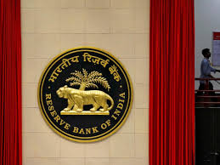
Central Banks:
Control a country’s money supply and interest rates.
Example: Reserve Bank of India (RBI), Federal Reserve (USA).
They regulate commercial banks to ensure economic stability.

Slide 15
KEY TERMS TO KNOW
Interest Rate: The cost of borrowing money or the reward for saving money.
Loan: Money borrowed from the bank with an obligation to repay with interest.
Deposit: Money placed in a bank account for safekeeping.
Credit Score: A measure of how likely you are to repay loans.
ATM: Automated Teller Machine for withdrawing or depositing cash.

Slide 16
WHY IS IT IMPORTANT?
Financial Security: Keeps money safe.
Economic Growth: Provides loans to businesses, creating jobs.
Convenience: Easy access to money through ATMs, online banking, mobile apps.
Global Trade: Facilitates international transactions for businesses.

